Slide 1

Algolizer – A Basic Algorithm Visualizer
1

Slide 2

“ALGOLIZER”
Major Project-I Presentation
In the subject of B E Computer Engineering (Sem VII)
Presented By
Mr. Raj Mhatre (41)
Miss. Aqsa Sarnaik (62)
Mr. Sahil Nakti (44)
Miss. Sherya Mhatre (42)
Under Guidance of :- Prof. Harishchandra Maurya

Slide 3
OUTLINE
1. Introduction and Motivation
2. Literature Review
3. Research Gap Analysis
4. Objectives and Scope of the Project work
5. Problem Statement
6. Proposed System Architecture and Flow chart
7. Experimental Setup
8. Implementation Details
9. Conclusion
10. References
Algolizer – A Basic Algorithm Visualizer
3

Slide 4

Introduction and Motivation
Alogolizer comprises of two words basically the Algorithm and the Visualization.
Algorithm: The word Algorithm means “A set of rules to be followed in calculations or other problem-solving operations.
Visualization: It is a process of representing data graphically and interacting with representation.
This project is basically visualization of various Algorithms in form of graphical representation.
algorithm visualizer is an interactive online plateform that visualizes algoritms from code.
learning algoritms gets much easier with the visualization and the graphical representation.
Algolizer – A Basic Algorithm Visualizer
4

Slide 5
Literature Review
Algolizer – A Basic Algorithm Visualizer
5

Slide 6
Literature Review
Sr. No | Authors Name | Objective | Method | Demerits
1 | PengSlavomir Simonik Jing | Its aim is to generate algorithm in graphical format with animation | It Displays GUI Form | Algorithms is Time consuming.
2 | Christopher D. Hundhausen Sarah A. Douglast John T. Stasko | The main Aim is to make easier to understand to the new learner | Generates Graphical Representation | The software cannot run on mobile
3 | Euripides Varchnos Athanassios Jimoyiannis | Its aim is to display different types of visualizing algorithm | It visualizes different algorithm | The selection of topic within the scope of subject is quite wide
Algolizer – A Basic Algorithm Visualizer
6

Slide 7
Comparison of different research work with respect to identified issues
Security Issues
Use in Mobile
Key Techniques Used
Used in Desktop
Dynamic Visualization
Simple to use
 | [ I ] | X | √ | √ | X | Its aim is to generate algorithm in graphical format with animation
 | [ II ] | X | √ | X | X | The main Aim is to make easier to understand to the new learner
 | [ III ] | X | √ | √ | X | Its aim is to display different types of visualizing algorithm
Research Papers
Algolizer – A Basic Algorithm Visualizer
7

Slide 8
Gap Analysis of Existing System
Concentrating on the sorting algorithms the existing proposed system considered more of theory of complex algorithm so due to that it was difficult to understand what the proposed system is about as well as harder to memorize.
Our project comprises more of visualization rather than just mugging this up and visualization is more effective than our traditional documentation.
The UI is easy to understand due to the graphical representation.
it is very basic and consist of basic 4 algorithm.
Algolizer – A Basic Algorithm Visualizer
8

Slide 9
Research Objectives
1. To Design User Friendly Website.
2. To represent Algorithms in Graphical form.
3. To show visually demonstrate how an Algorithm works.
4. Simplify Algorithms for easier comprehension.
Algolizer – A Basic Algorithm Visualizer
9

Slide 10
Scope of Proposed Work
1. Easier to understand various algorithms.
2. Graphically represent all algorithm.
Algolizer – A Basic Algorithm Visualizer
10

Slide 11
Problem Statement
An algorithms are hard to understand theoretically. We can understand easily by visualizing such kind of algorithms. Create a application or Website that show the working of Algorithms in graphical form.
Algolizer – A Basic Algorithm Visualizer
11

Slide 12
Proposed System
Introduction
The proposed system involves the simulation of the different type of sorting algorithms codes. The scope has its limitations. Only 4 types of sorting algorithms codes are created which are Insertion sort, Selection sort, Comb sort and Shell sort. Only the Website Development has began. It can be used in Pc, Desktop and even Mobiles. Once the synthesize and simulation of the codes for the software application have been run, the following animations will show how successfully data sets from distinct unsorted data can be sorted using distinct algorithms.
Algolizer – A Basic Algorithm Visualizer
12

Slide 13
Proposed System
Algorithms
Insertion Sort
Selection Sort
Step 1 - If the element is the first element, assume that it is already sorted. Return 1.
Step2 - Pick the next element, and store it separately in a key.
Step3 - Now, compare the key with all elements in the sorted array.
Step 4 - If the element in the sorted array is smaller than the current element, then move to the next element. Else, shift greater elements in the array towards the right.
Step 5 - Insert the value.
Step 6 - Repeat until the array is sorted.
Step 1: Repeat Steps 2 and 3 for i = 0 to n-1
Step 2: CALL SMALLEST(arr, i, n, pos)
Step 3: SWAP arr[i] with arr[pos]
Step 4: EXIT
SMALLEST (arr, i, n, pos)
Step 1: [INITIALIZE] SET SMALL = arr[i]
Step 2: [INITIALIZE] SET pos = i
Step 3: Repeat for j = i+1 to n
if (SMALL > arr[j])
SET SMALL = arr[j]
SET pos = j
[END OF if]
Step 4: RETURN pos
Algolizer – A Basic Algorithm Visualizer
13

Slide 14
Proposed System
Algorithms
Comb Sort
Shell Sort
Step 1 START
Step 2 Calculate the gap value if gap value==1 goto step 5 else goto step 3
Step 3 Iterate over data set and compare each Item with gap item then goto step 4.
Step 4 Swap the element if require else goto step 2
Step 5 Print the sorted array.
Step 6 STOP
Step 1- for (interval = n/2; interval > 0; interval /= 2)
Step 2-for ( i = interval; i < n; i += 1)
Step 3- temp = a[i];
Step 4- for (j = i; j >= interval && a[j - interval] > temp; j -= interval)
Step 5- a[j] = a[j - interval];
Step 6:- a[j] = temp;
Algolizer – A Basic Algorithm Visualizer
14

Slide 15
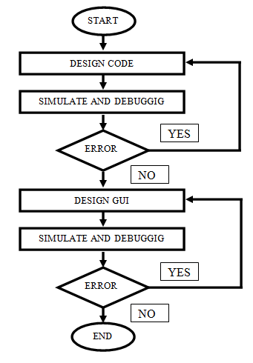
System Design
Algolizer – A Basic Algorithm Visualizer
15

Slide 16
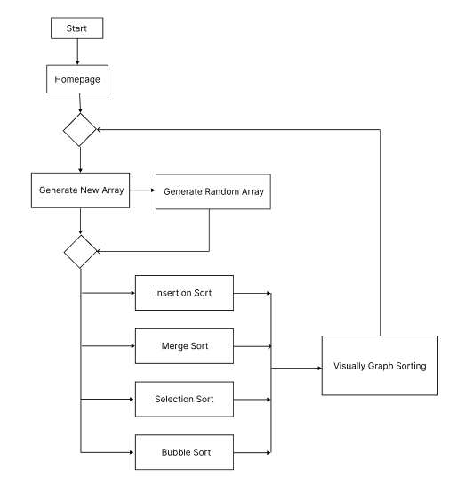
Flowchart
Algolizer – A Basic Algorithm Visualizer
16

Slide 17
Software & Hardware Requirements
Hardware Requirements
Hardware Requirements
Hardware - Pentium
Speed – 1.1 GHz
Ram- 1 GB
Hard Disk – 20GB
Key Board - Standard Windows Keyboard
Mouse – Two or Three Button Mouse
Monitor - SVGA
Software Requirements
Operating System- Windows
Technology – Web 2.0
Web Technologies – HTML, Css, JavaScript
IDE– VS Code
Client – Google Chrome, IE
Algolizer – A Basic Algorithm Visualizer
17

Slide 18
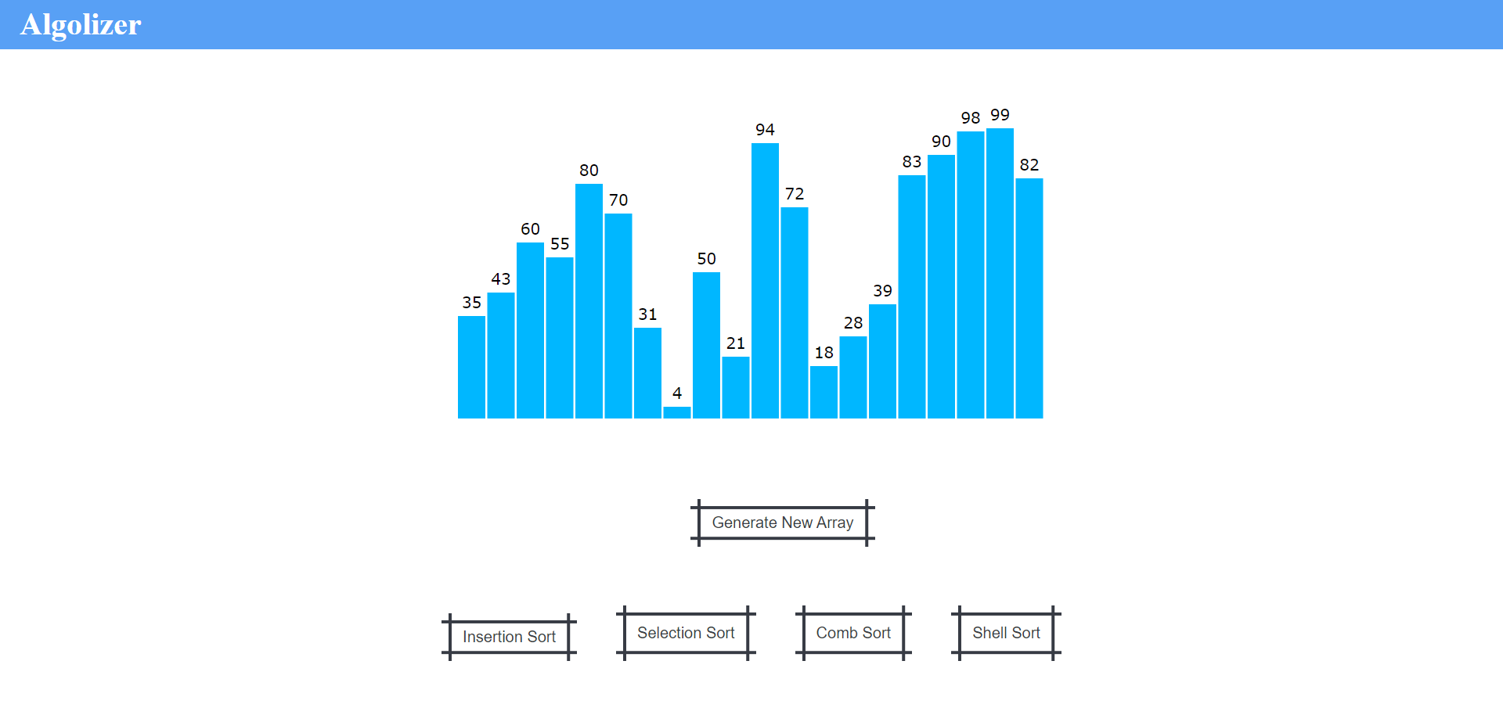
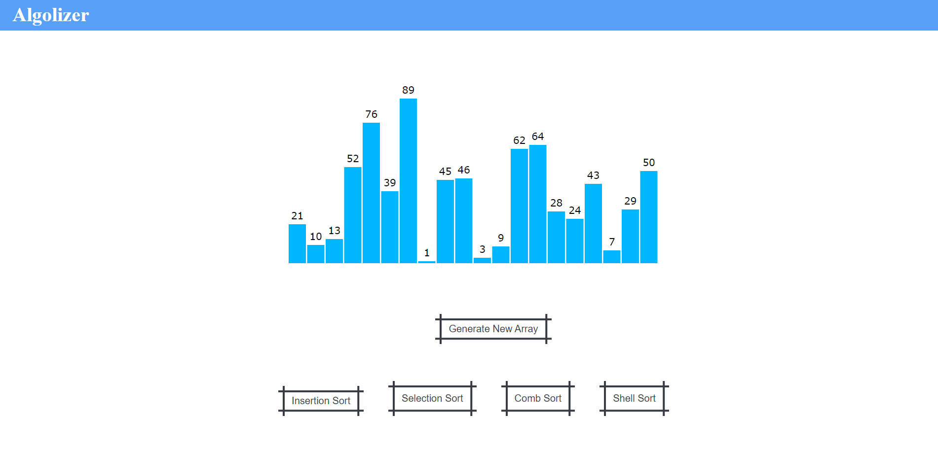
Implantation Work
Algolizer – A Basic Algorithm Visualizer
18

Slide 19
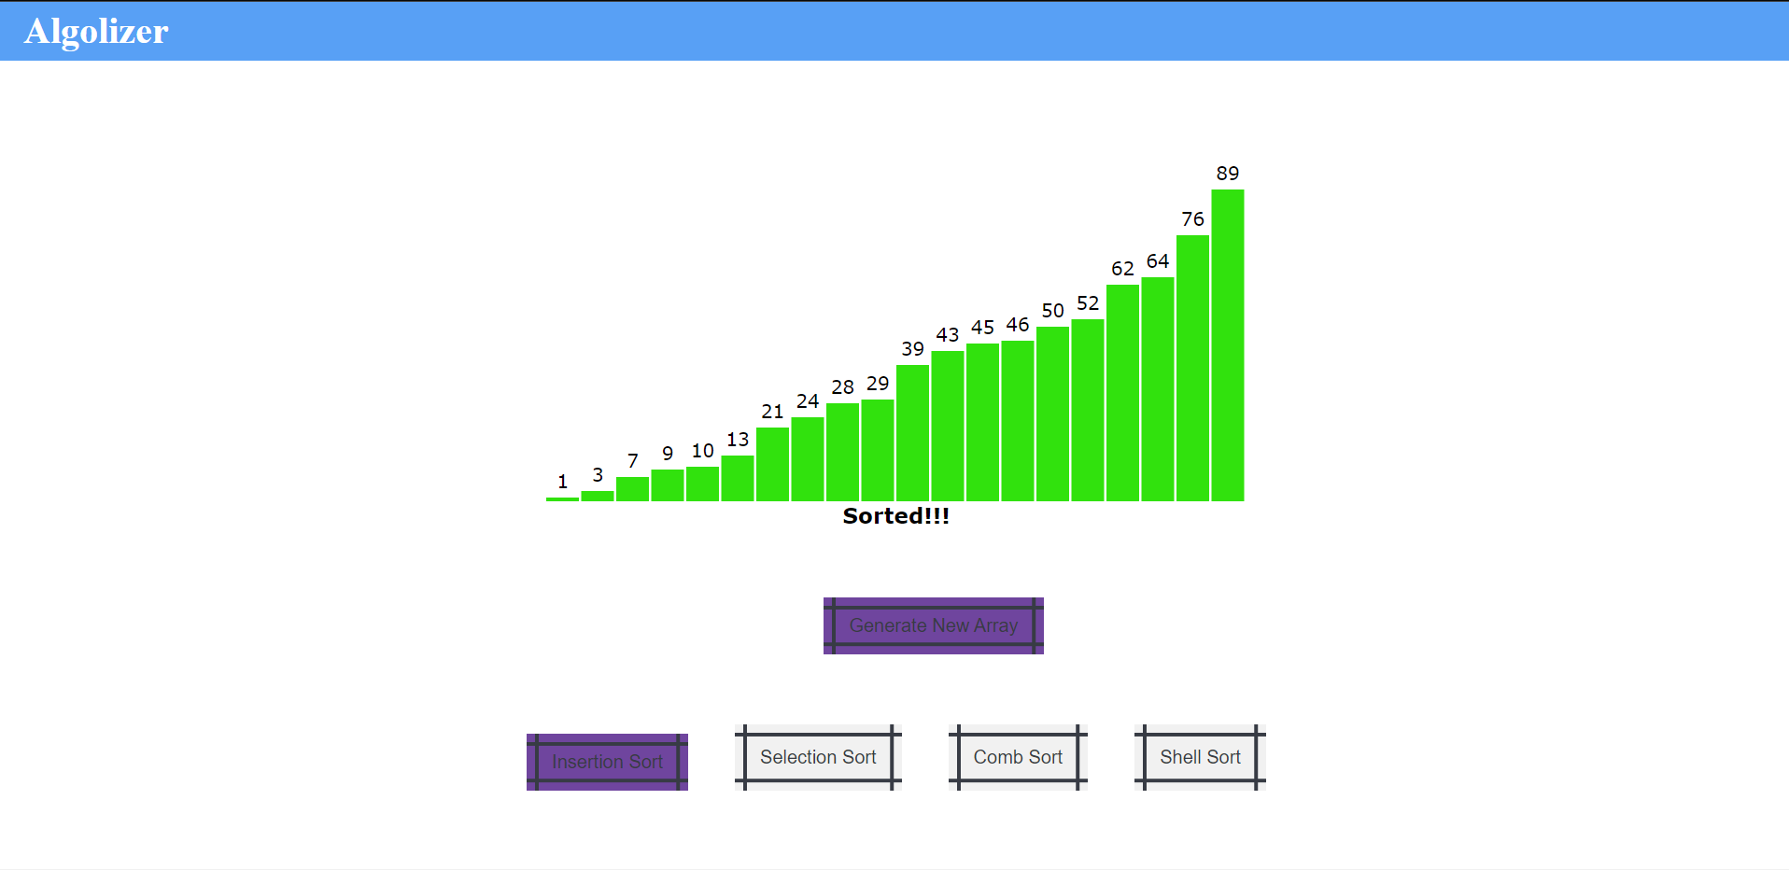
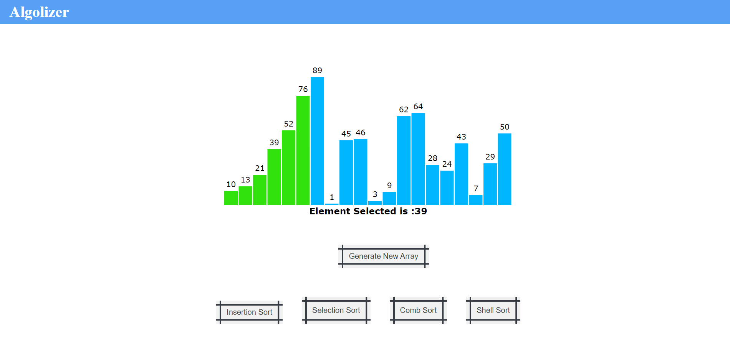
Implantation Work
Algolizer – A Basic Algorithm Visualizer
19

Slide 20

Conclusion
According to our findings, algorithm visualization can be seen as a valuable supporting tool, used in addition to standard ways of education in the field of computer science. Within the paper we provided an overview of the Algolizer algorithm visualization platform as well as our practical experiences with the system. We believe (and the results of questionnaire support our belief ) it helps to improve the quality of education in the field and contribute to the solution for some of the problems in higher education mentioned at the beginning of the paper
Algolizer – A Basic Algorithm Visualizer
20

Slide 21
Reference
[1]CORMEN, T. H.; LEISERSON, C. E.; RIVEST, D. L.; STEIN, C. Introduction to algorithms. Second Edition. 2001. ISBN 0-262-03293-7.
[2]KNUTH, D. The Art of Computer Programming: Fundamental Algorithms. Third Edition. 2004. ISBN 0-201-89683-4.
[3]SIPSER, M. Introduction to the Theory of Computation. Boston, MA: PWS Publishing Company, 1997. ISBN 0-534-94728-X.
[4]BĚLOHLÁVEK, R. Algoritmická matematika 1 : část 2. Available also from: hhttp://belohlavek.inf.upol.cz/vyuka/algoritmicka-matematika-1-2.pdfi.
[5]KNUTH, D. The Art of Computer Programming: Sorting and Searching. Second Edition. 2004. ISBN 0-201-89685-0.
[6]SEDGEWIK, R. Algorithms in C : Fundamentals, data structures, sorting, searching. Third Edition. 2007. ISBN 0-201-31452-5.
[7]GeeksforGeeks. Available from: hhttps://www.geeksforgeeks.org/i.
[8]BĚLOHLÁVEK, R. Algoritmická matematika 1 : část 1. Available also from: hhttp://belohlavek.inf.upol.cz/vyuka/algoritmicka-matematika-1-1.pdfi.
[9]Stackoverflow. Available from: hhttps://stackoverflow.com/i.
[10]Java documentation. Available from: hhttps://docs.oracle.com/javase/8/i.
Algolizer – A Basic Algorithm Visualizer
21

Slide 22

Thank you
Algolizer – A Basic Algorithm Visualizer
22

